Slide 1

Albany Med–Predicting Factors Influencing Length of Stay
Katelin Fugon <fugonkj@clarkson.edu>,
Edilawit Gebreselassie <gebreses@clarkson.edu>,
Sarah Mastrolia <mastrosm@clarkson.edu
HC643
July 2021

Slide 2
Objective
The purpose of these analyses is to identify predictive factors for overtay.
Three diagnostic categories were examined: Circulatory, Infectious & Parasitic Diseases, and Nervous System
The data were also examined as a whole prior to being broken down into the three smaller subcategories.

Slide 3
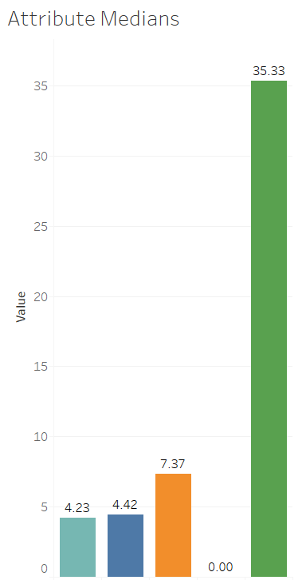
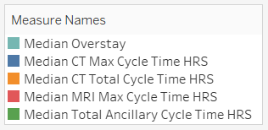
Prediction Model for Three Major Diagnostic Categories
Diagnostic Categories
Circulatory System
Nervous System
Infectious and Parasitic Disease
Random Forest is the best model for prediction
Attributes that support prediction
Total Ancillary Cycle Time HRS
(Sum of total time between all CT, MRI, US, and XR orders and scans)
CT Max Cycle Time HRS
(Sum of time between computerized tomography (CT) orders and scans)
MRI Max Cycle Time HRS
(Maximum amount of time between magnetic resonance imaging (MRI) orders and scans)
CT Total Cycle Time HRS
(Sum of time between computerized tomography (CT) orders and scans)
Notes:
In this analysis we first begin establishing the prediction model for overstay in the three major diagnostic categories; Circulatory System, Nervous System, and Infectious and Parasitic Disease. Using Rapid Miner Statistical Software, and using the auto model feature, the attributes found that support prediction are total ancillary cycle time hours, which is the sum of total time between all CT, MRI, US, and XR orders and scans, CT Max Cycle Time hours, which is the sum of time between CT orders and scans, MRI max cycle time hours which is the maximum amount of time between MRI orders and scans, and CT total cycle time hours which is the sum of time between CT orders and scans. We compute these attributes’ medians to have less skewed data, thus limiting outliers, in addition to Median Overstay, which is a newly created attribute that takes the difference of Vizient Expected Inpatient LOS and Albany Med’s Inpatient Length of Stay Number, which are already existing attributes in the dataset. We find that between these three diagnostic categories the median overstay is 4.23 days, the median CT max cycle time is 4.42 hours, median CT total cycle time is 7.37 hours, and what’s interesting is the median MRI max cycle is 0 hours, and yet the median total ancillary cycle time is 35.33 hours. In this comparison of cycle times, there is indication that there is a lack of efficiency in performing CT scans, except in the case of MRI scans.

Slide 4
Infectious Disease Prediction Model
Random Forest is the best model for prediction
Attributes that support prediction:
CT Total Orders CNT
(Total number of orders for computerized tomography (CT) scan)
CT Max Cycle Time HRS
(Sum of time between computerized tomography (CT) orders and scans)
X-Ray Total Orders CNT
(Total number of orders for x-ray (XR) scan)
X-Ray Total Performances CNT
(Total number of x-ray (XR) scans)
Notes:
We begin to dissect these three major diagnostic categories separately and using Rapid Miner, it is found that random forest is the best model for prediction, and auto model finds that the important attributes that support prediction are CT total orders count which is the total number of orders for CT scan, X-ray total orders count which is the total number of orders for xray scan, and xray total performances count which is the total number of xray scans (or orders completed).

Slide 5
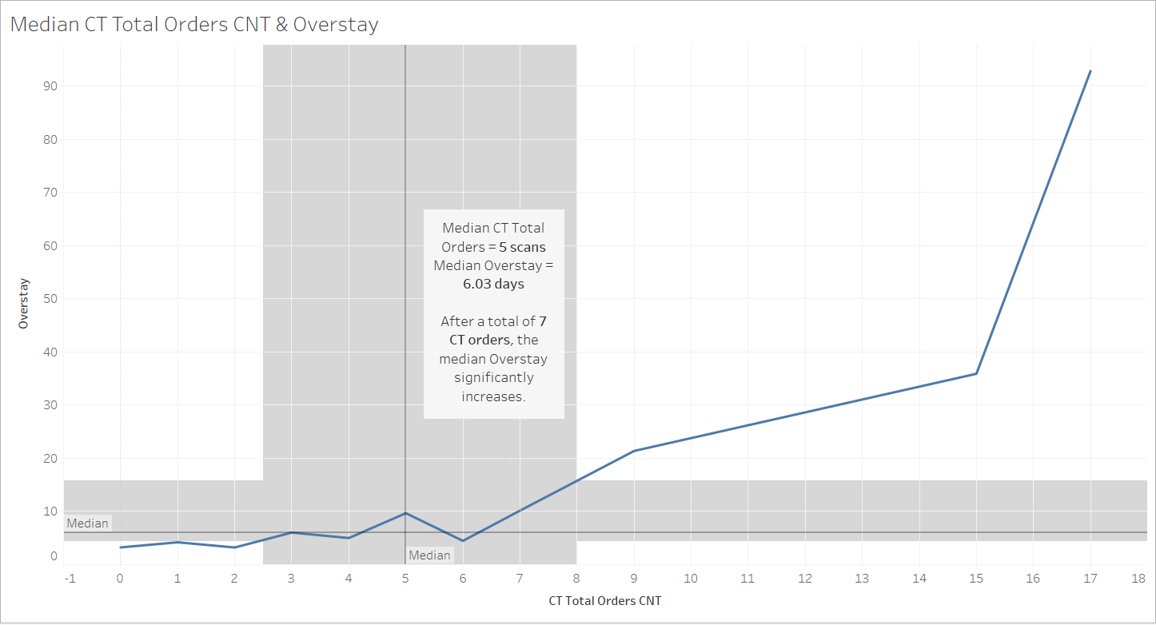
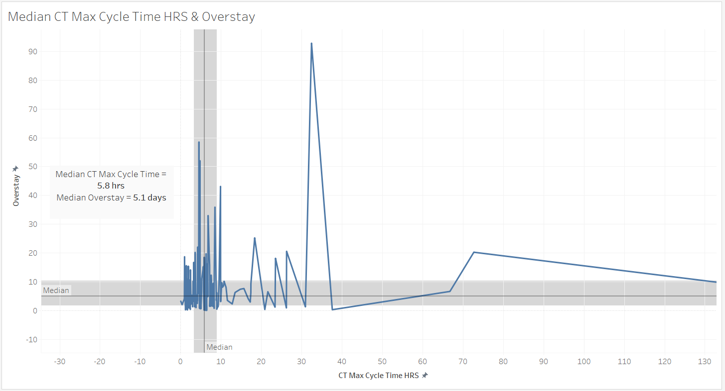
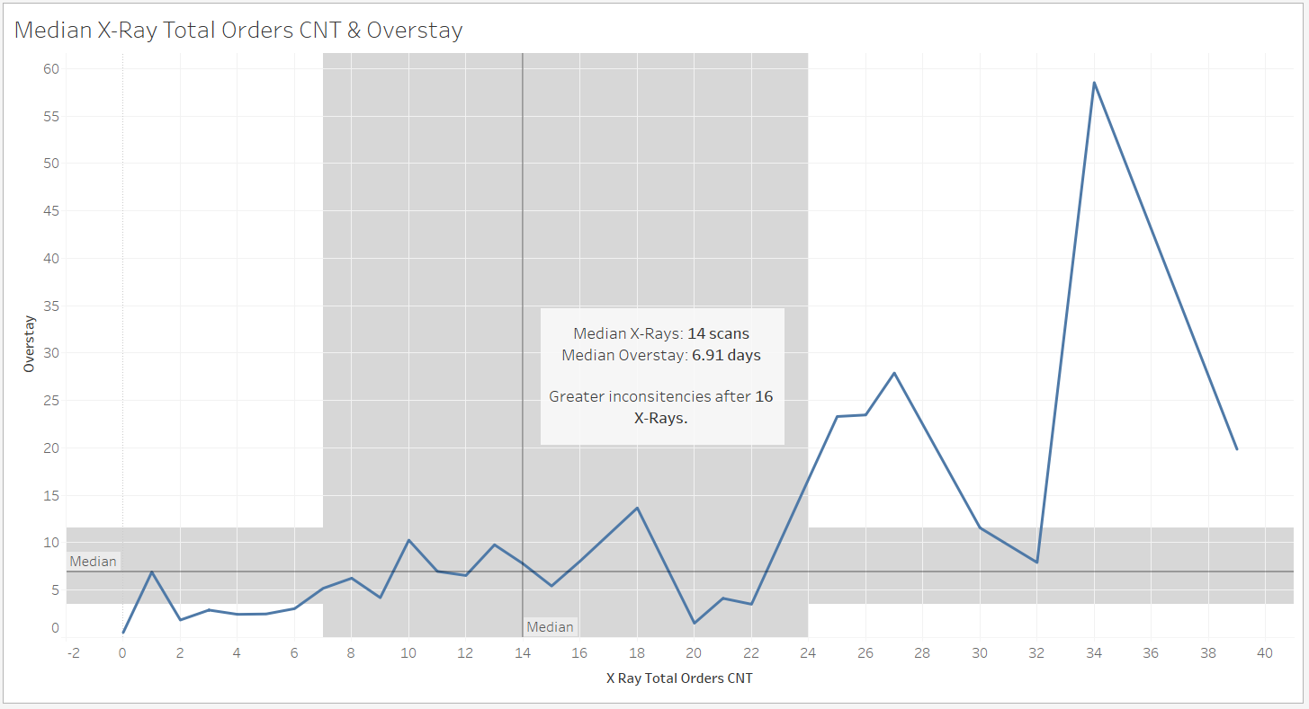
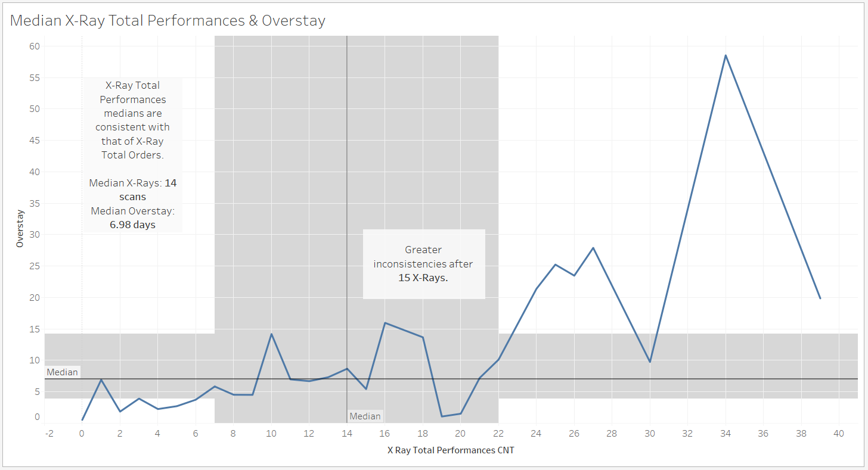
Infectious Disease Analysis
Notes:
Using Tableau statistical visualization software, I began to compare these attributes’ medians against overstay using line graphs. Taking a look at the top left corner, CT Total Orders Count & Overstay, the median is 5 scans equating to 6.03 days, and after a total of 7 ct orders, the median overstay significantly increases. To the right of this graph, CT Max Cycle Time hours & Overstay, the median is 5.8 hours, equating to 5.1 days, where there is great variance among patients. Bottom left compares X-ray total orders count & overstay, where the median is 14 scans equating to 6.91 days. There are greater inconsistencies after 16 x-rays. Lastly, we compare X-ray total performances & overstay, the median is 14 scans, equating to 6.98 days, and find x-ray total performances medians are consistent with that of x-ray total orders. There are greater inconsistencies after 15 x-rays.

Slide 6
Analysis Recommendations for Patient Overstay with Infectious Disease:
Keep CT Total Orders count ≤ 7.
CT Max Cycle Time HRS varies greatly among patients, much consideration should be to standardize the maximum time between orders and scans; staying consistent with the median, a maximum cycle time of 5.8 hours.
X-Ray Total Orders and X-Ray Performances compliment each other, the total scan orders and total scans completed should be ≤ 15.
CTs and X-Rays contribute to an increased patient LOS; use an alternate means of imaging for diagnosing infectious diseases, such as ultrasound or MRI.
Notes:
The following recommendations for patient overstay with infectious and parasitic diseases is to keep the CT total orders count less than or equal to 7. CT Max Cycle time hours varies greatly among patients, much consideration should be to standardize the maximum time between orders and scans; staying consistent with the median, a maximum cycle time of 5.8 hours. X-ray total orders and x-ray performances compliment each other, the total scan orders and total scans completed should be less than or equal to 15. And CTs an X-rays contribute to an increases patient LOS; consideration should be had on using alternate means of imaging for diagnosing this disease such as ultrasound or MRI, when appropriate that is.

Slide 7
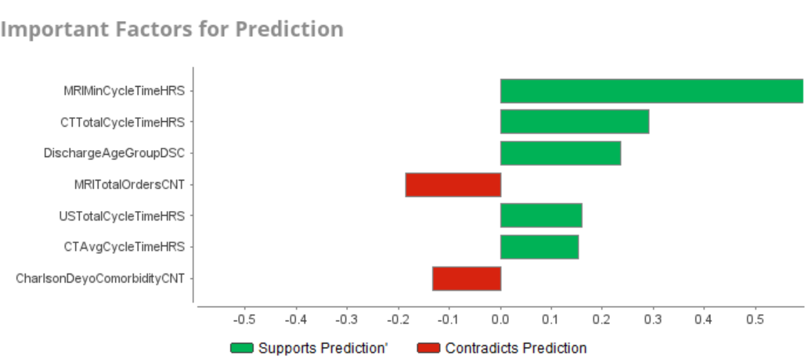
Circulatory System – Generalized Linear Model

Slide 8
Definition of Terms
Data Element | Description
MRITotalOrdersCNT | Total number of orders for magnetic resonance imaging (MRI) scan.
CTTotalCycleTimeHRS | Sum of time between computerized tomography (CT) orders and scans.
DischargeAgeGroupDSC | Categorization by age at time of discharge.
USTotalCycleTimeHRS | Sum of time between ultrasound (US) orders and scans.
CTAvgCycleTimeHRS | Average amount of time between computerized tomography (CT) orders and scans.

Slide 9
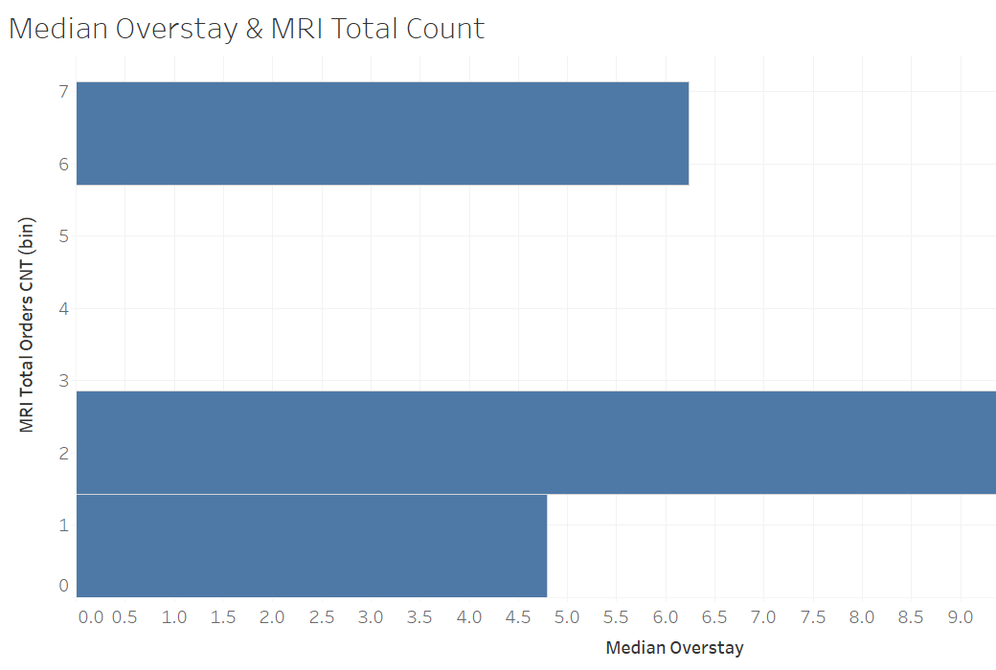
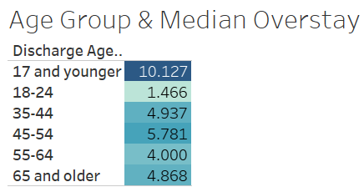
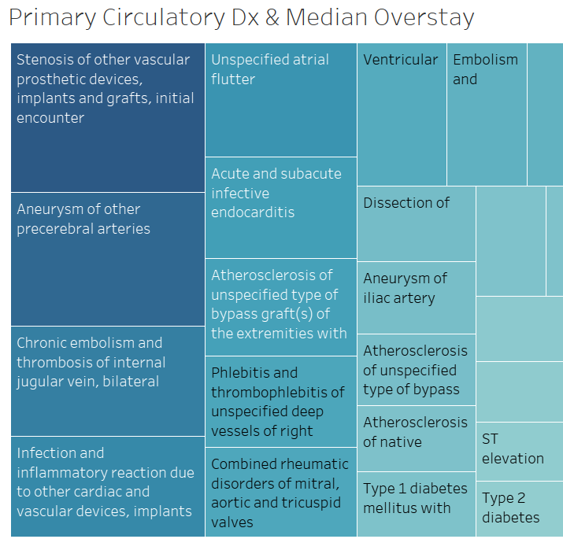
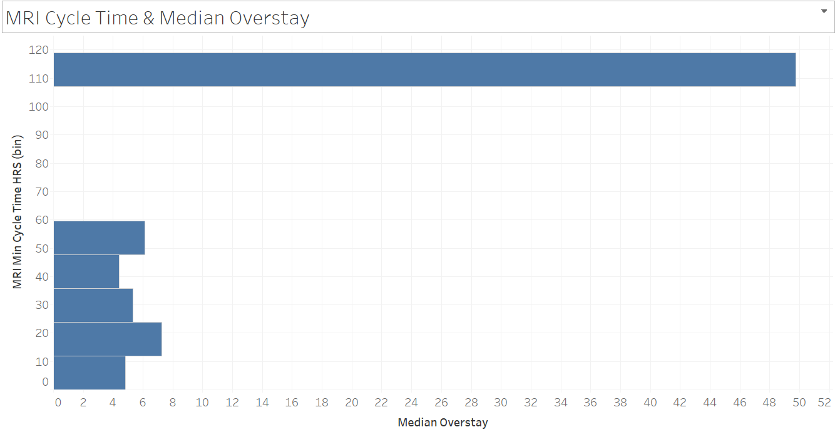
Circulatory System
Notes:
In the visuals seen here, we see the relationship of factors affecting overstay for patients with primary admission diagnoses related to the circulatory system. Based on the generalized linear model, we see that three of the five predictive factors involve the total amount of time from the moment the imaging order is submitted by the provider and the time the time the order is completed (CTTotalCycleTimeHRS, USTotalCycleTimeHRS & CTAvgCycleTimeHRS). The histogram in the bottom left shows one example of how increased imaging cycle time relates to overstay. This may be a function of a delay of diagnosis due to delay between the imaging order being entered and the imaging being completed. This can result in delay of treatment and, thus, delay of care and worsened patient outcomes.
The treemap in the lower righthand corner shows the primary circulatory system diagnosis in relation to their respective median overstay. The darker blue and larger the rectangle the longer the associated overstay.
The upper righthand corner shows us the associated median overstay for each age group. Pediatric patients, ages 17 and younger is associated with the longest median overstay.
The histogram in the upper left-hand corner displays the total count of MRIs ordered and median overstay. Based on this, patients who receive orders for two or more MRIs may be prone to longer overstay. The higher number of MRIs required may be indicative of more complicated diseases states. Thus, these patients may benefit from closer medical or case management.

Slide 10
Recommendations – Circulatory System
Reduce time between imaging order entry and order completion
Could use the reasoning to advocate for more ultrasound and CT technician staffing → could reduce turn around time → reduction in overstay
Flag patients who receive orders for a certain number MRIs for additional case management
Receiving two MRI orders is associated median overstay of 9 days
Interventions to reduce excessive length of stay in these patients can reduce median overstay
Assign pediatric patients additional case management to identify factors that could contribute to unnecessary excessive LOS

Slide 11
Nervous System Prediction Model
Best predictor: Decision Tree Model
Critical Attributes:
X-rayTotalPerformanceCNT Total number of x-ray (XR) scans.
CTTotalOrdersCNT
Total number of orders for computerized tomography (CT) scan.
X-rayTotalOrdesCNT
Total number of orders for x-ray (XR) scan.

Slide 12
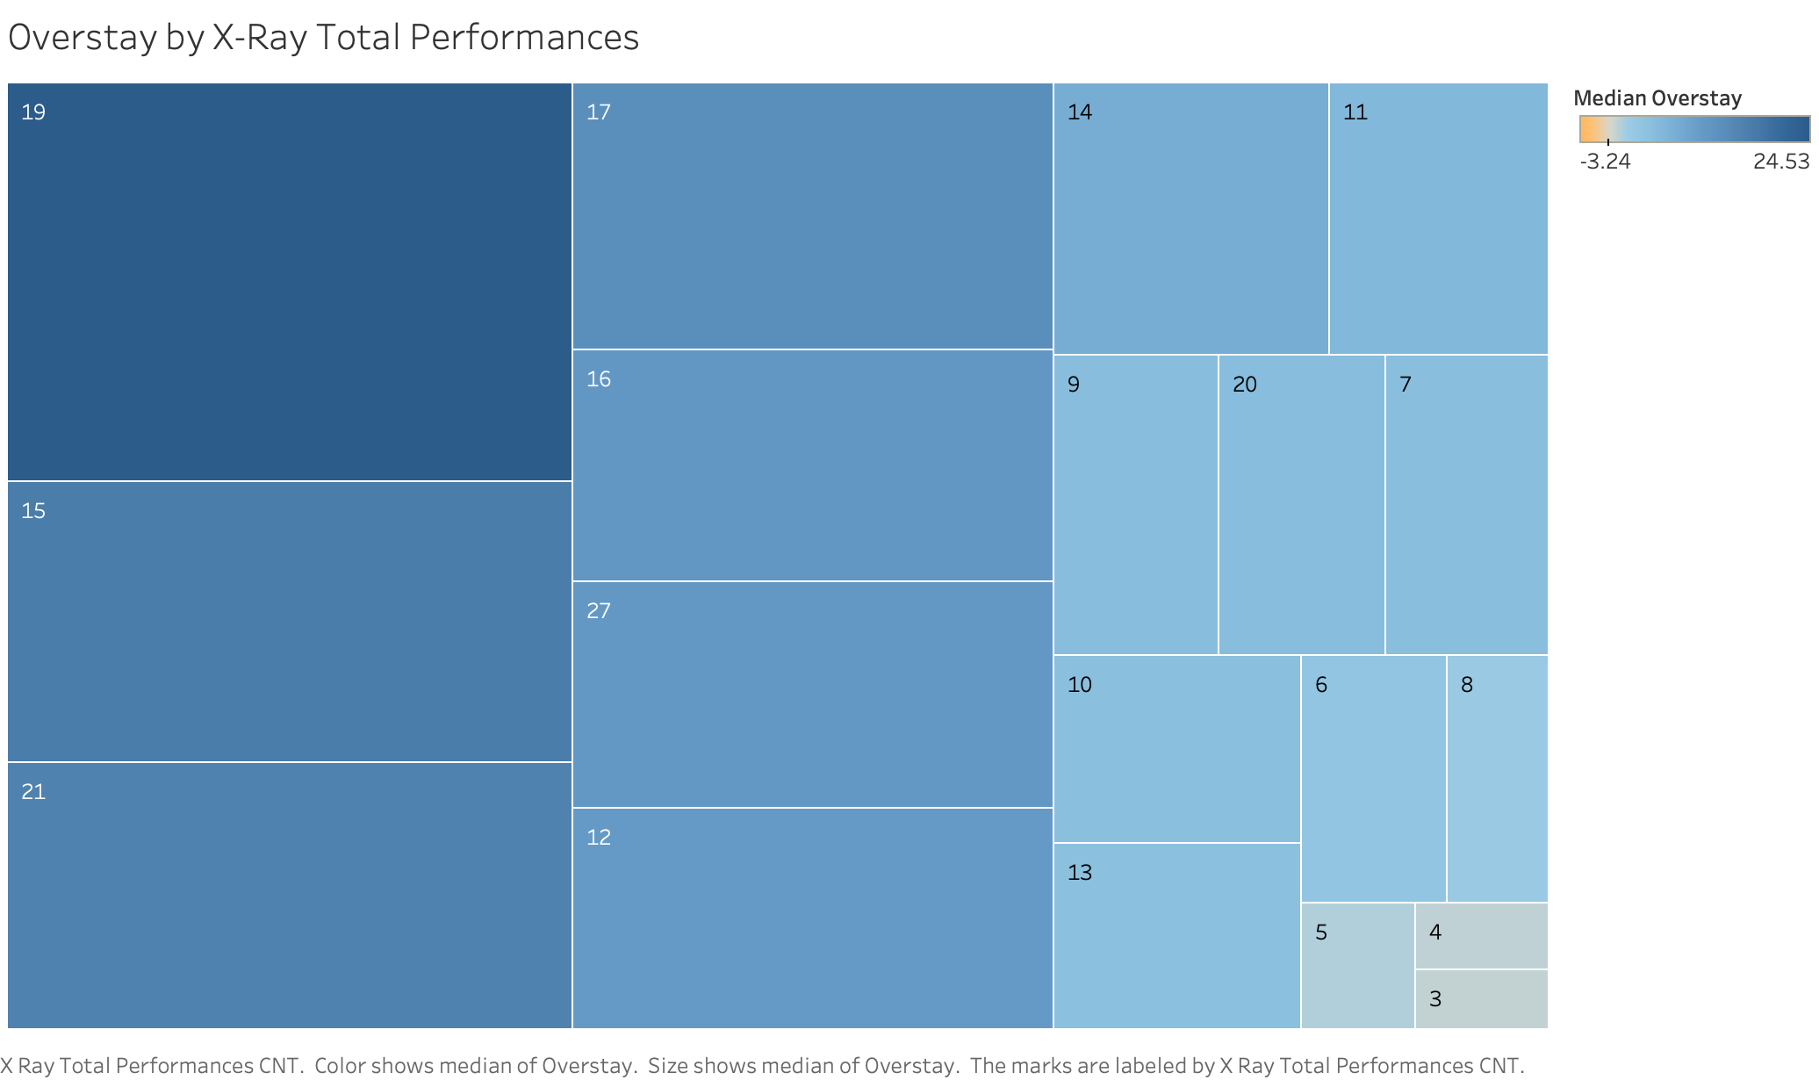
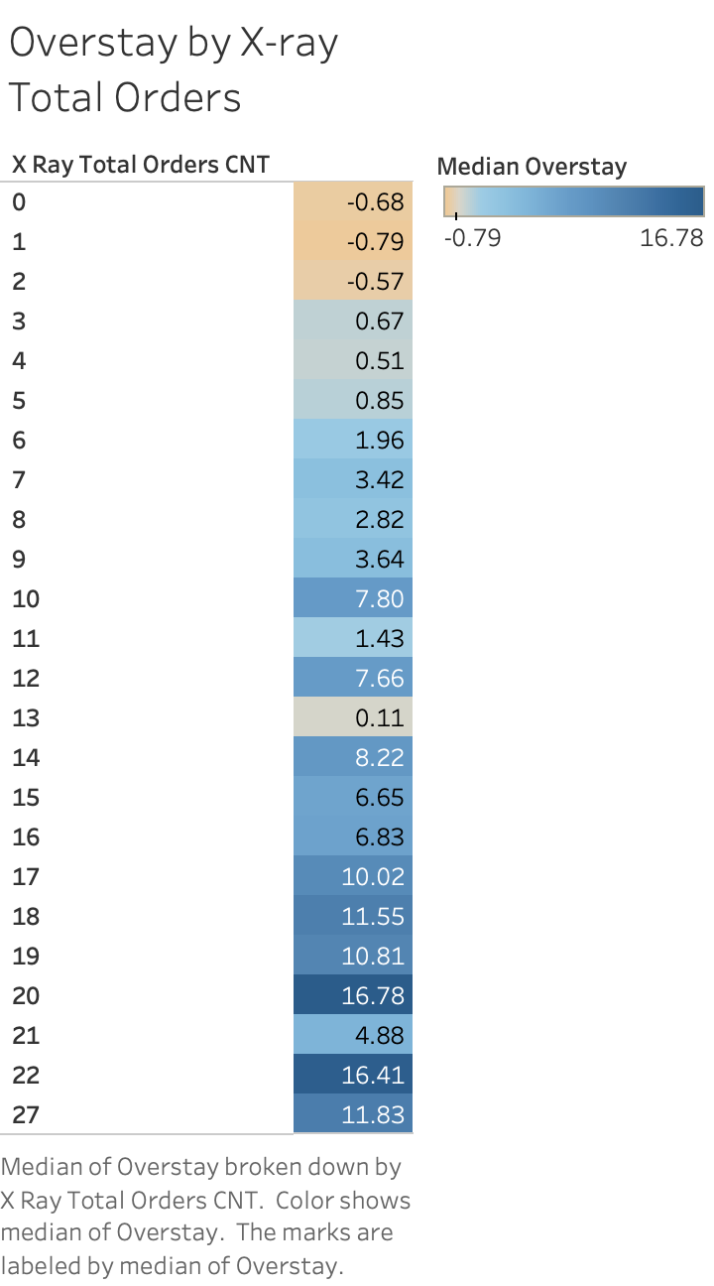
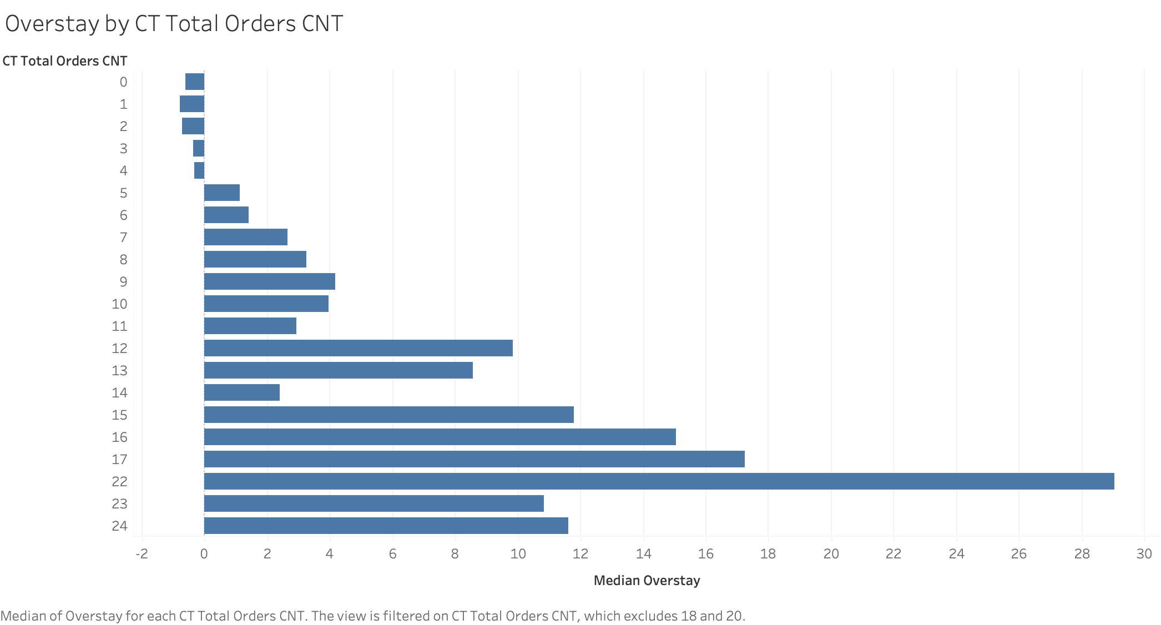

Slide 13
Recommendations: Nervous System
Reduce the number of X-ray Performance and Orders
Reduce the number of CT Scan Orders
Order sets/standing orders Vs single orders
Radiology-Referring provider relationship
Minimize variation in MRI and X-ray cycle time
Emergency Admits experience the highest MRI and X-ray total cycle time
Reduce utilization rate of imaging devices by other departments

Slide 14
Overall Recommendations
Implications for scheduling
Having dedicated time slots for emergency patients requiring imaging
Disproportionate amount of emergency patients had highest total cycle time for x-ray and MRI
Delayed diagnosis times leading to delayed treatment and eventual overstay
Implications for staffing to reduce total cycle times
Unnecessary imaging
Flagging patients for intervention after a certain number of imaging diagnostics are ordered

Slide 15

Any Questions?

